Slide 1
Lecture 36 – Kruskal’s Algorithm
CST370 – Design & Analysis of Algorithms
Dr. Byun
Computer Science

Slide 2
Lecture Objectives
After completion of this lecture, you will be able to
  explain the operation of Kruskal’s algorithm to find the MST of a graph.

Slide 3
Chapter 9: Greedy Technique
9.1 Prim’s Algorithm
9.2 Kruskal’s Algorithm
9.3 Dijkstra’s Algorithm
9.4 Huffman Trees and Codes

Slide 4
Kruskal’s Algorithm
Another greedy algorithm to find the MST of a weighted graph.
  Sort the edges of a graph in non-decreasing order of weights.
  Grow the tree by adding one edge at a time from the sorted list unless this edge would create a cycle.

Slide 5
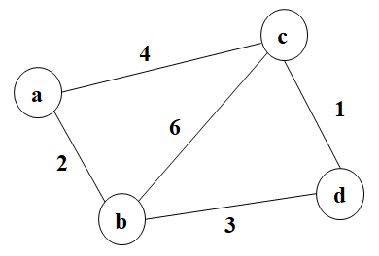
Example

Slide 6
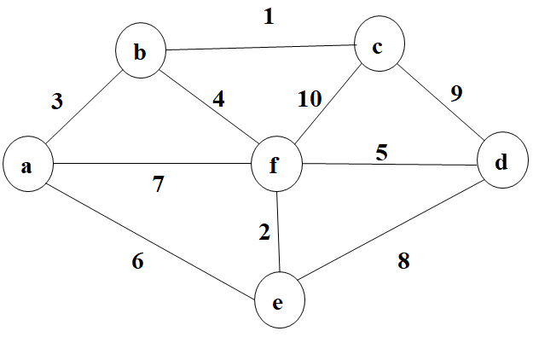
Exercise

Slide 7
Comment on Kruskal’s Algorithm
The algorithm looks easier than Prim’s algorithm.
  But it’s hard to determine a cycle.
  To check the existence of a cycle, we use the union-find algorithm.

